Slide 1
Ch. 6: Equilibrium
The Price is “Right”!

Slide 2
DO Now
Pick up handouts
Ch. 5 Quiz—Open Notes
Quiz in the tray when done
Get out a sheet of paper for Warm-up Questions

Slide 3
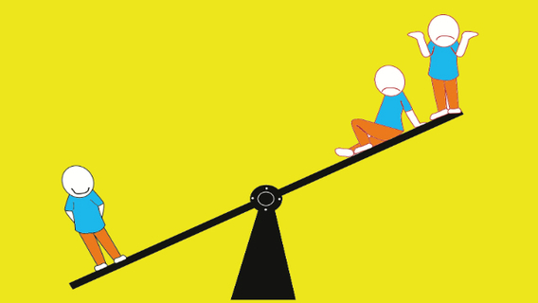

warm-up questions
Think of a product you have recently purchased and the price you paid, and consider these questions...
1) Why were you willing to buy this product at this price?
2) Why do you think the seller was willing to sell this
product at that price?
3) Do you think you paid the "right" price? Why or why not?

Slide 4
Today’s Learning Target
I can explain what market equilibrium is and how it is established.
I will show I understand by graphing and answering questions related to demand/supply graphs.

Slide 5
ToDAY’s LeSSON
Objective:
EC.2.5 Explain how the interaction of supply & demand determine equilibrium price.
ESSENTIAL QUESTIONS:
-What influences supply & demand?
-How is price determined in a market economy?

Slide 6

CONCEPT PREVIEW
Econmovies: Indiana Jones

Slide 7
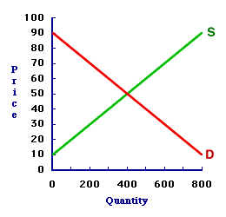
Market Balance:
Interaction between consumers and producers drives prices to a market equilibrium point at which the quantity demanded and the quantity supplied are equal.
The equilibrium price is set at this intersecting point.

Slide 8
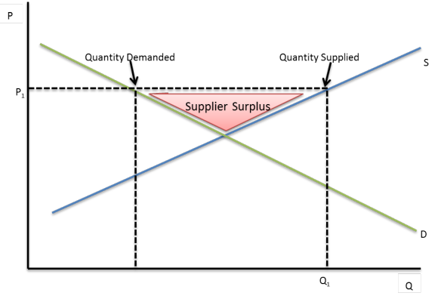
Market imbalance:
A surplus occurs when the price is set too high. Quantity supplied (QS) > quantity demanded (QD)

Slide 9
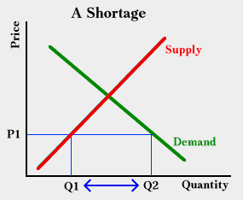
Market imbalance:
Shortage occurs when price is set too low. Quantity demanded (QD) > quantity supplied (QS).

Slide 10
Gov’t Intervention IN Mixed-Market Economies
Price controls – government placed limits on how high or low certain prices may be.
The gov’t may realize that supply and demand will result in prices that are:
- unfairly high for consumers
or
-unfairly low for producers.

Slide 11
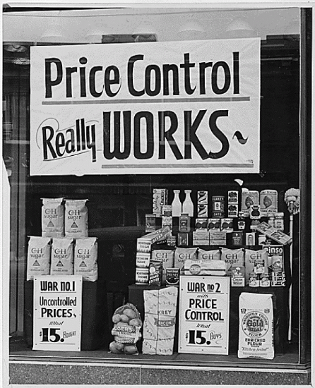
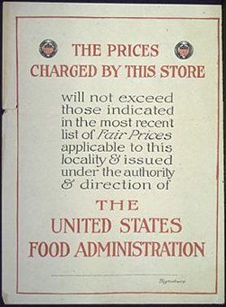
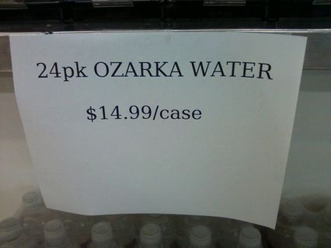
Gov’t Intervention IN Market Economies
When????
-during wartime (especially on “critical” goods)
-during natural disasters or
other times of unrest (hurricanes, terrorist attacks, etc.)
-to prevent a “glut” in the market (commodities like wheat, corn, etc. or on imported goods like cars)

Slide 12
TWO KINDS OF PRICE CONTROLS
PRICE FLOOR:
When a gov’t wants to keep prices from going too low, it sets a minimum price consumers are required to pay for a good/service.
A price below the floor is illegal.
Price floors protect producers by ensuring profit.
But, they also protect consumers by keeping more producers in the market (competition).

Slide 13
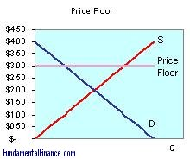
A price floor is ABOVE equilibrium price on the supply & demand graph.
Would producers be allowed to sell this good or service at $2.50?
At $4.00?

Slide 14
Price floor examples
The minimum wage is a government-imposed legal floor on the hourly wage rate which is the price the market pays for labor.
A floor on a crop price, if world market supply increases or treaties force prices to drop.

Slide 15
Price floors usually result in a SURPLUS.
At the price control ($3.00), the supply is GREATER than
the demand.
If the floor is removed, price would settle AT equilibrium ($2.00)

Slide 16
PRICE CEILING:
When a gov’t wants to keep prices from going too high, it sets a maximum price consumers are required to pay for a good/service.
A price above the ceiling is illegal.
Price ceilings protect consumers.
But, it also protects producers’ business.

Slide 17
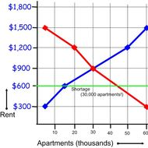
Would producers be allowed to sell this good or service at $300?
At $900?
A price ceiling is BELOW equilibrium price on the supply and demand graph.

Slide 18
At the price control ($600), the demand is GREATER than
the supply.
If the ceiling is removed, price would settle AT equilibrium ($900)
Price ceilings usually result in a SHORTAGE.

Slide 19
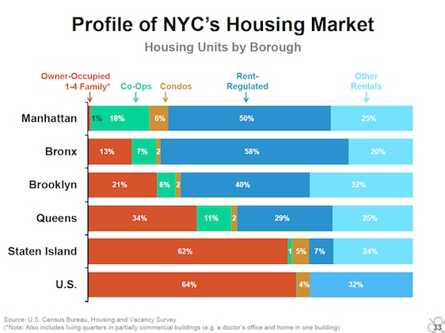
Price ceiling example
Rent Control in major cities where supply of apartments is less than demand. Landlords cannot charge more than the ceiling.

Slide 20
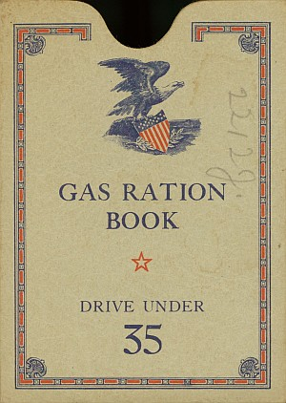
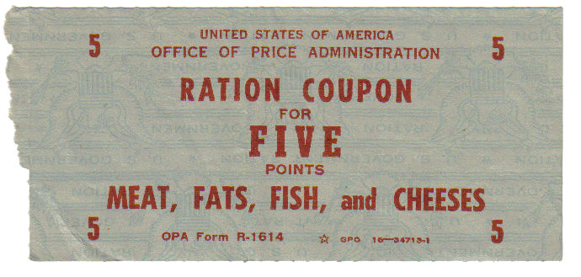
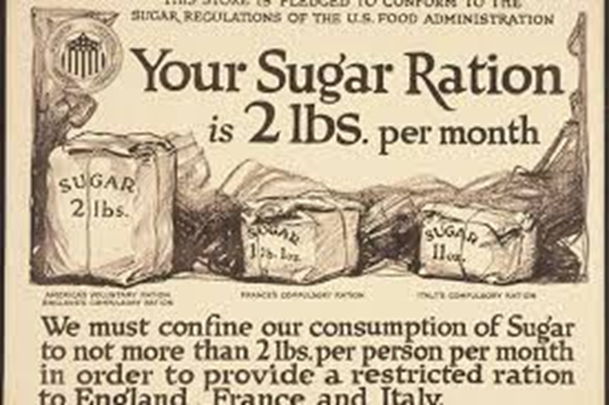
Dealing with SHORTAGES
When shortages occur, the government may impose rationing, which is the controlled distribution of a limited supply of a good or service.

Slide 21

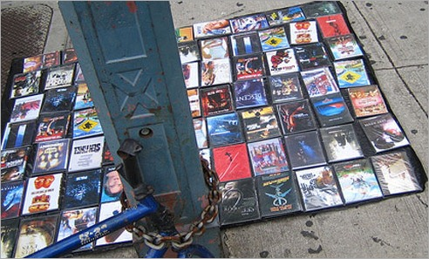
Shortages can also give rise to black markets, an illegal market in which goods are traded at prices or in quantities higher than those set by law.

Slide 22
DO Now-Day 2…
Thought of the day—
Be the motivation, not the distraction.
Rob Hill Sr.
Get your graded work from your folder
MAKE-UP QUIZZERS—get a LMC pass
Get out your Banana Market handout (or get it from the tray)

Slide 23
Today’s Learning Target
I will be able to explain how producers & consumers establish market equilibrium. I will analyze data and find where market price is established.
I will show I understand what market equilibrium is and how market price is determined by participating in a banana market activity, using the data collected there to create a supply & demand graph for this market, and determining market price.

Slide 24
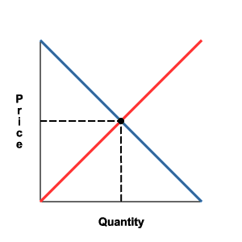
EXIT TICKET

